Slide 1
Giant Step Teen Conference
Inclusion, Harmony, Acceptance

Slide 2
“We must cure the disease of intolerance. No us. No them. Just we.”
Notes:
An inspiration to start the PowerPoint.
Quote is from Student Comments 2016.

Slide 3
Giant Step Basics
A free annual teen conference started in 1983. Held on Wayne State’s campus.
About 300 ninth and tenth graders are recruited from across metro Detroit, from charter, public, private, parochial and home schools. The goal is to have every race, ethnicity, cultural, geographic and economic background represented.
Teens are assigned to a discussion table with 7 other teens they do not know.
Trained facilitators lead ice breakers and discussions to help the teens break down superficial barriers and reveal what they have in common.
Four hours later, strangers leave as friends.

Slide 4
“There is more that unites us, than divides us.”
Notes:
This slide holds the Video Highlights. Scroll over the center of the slide and the play bar should appear. You will need sound access.
The quote is from Student Comments 2015.

Slide 5
Does it Work?
Students complete surveys before and after the conference.
Results consistently show that Giant Step positively affects their openness to people who seem different to them.

Slide 6
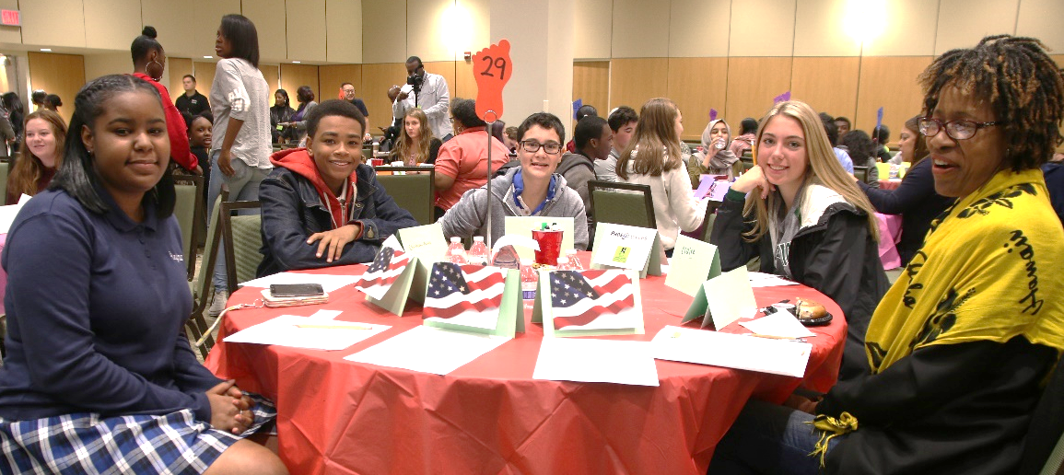
Percentage of Teens Who Strongly Agree (2017)
The group leader guided us but let us express our own opinions. 92%
Talking with teens from different backgrounds was interesting and educational. 91%
A positive experience; I recommend my school continue to participate. 92%
I was able to talk about the issues that were important to me. 81%
I feel more confident and can make choices to lead to a better future. 82%
I will stay in touch with the new people I met at Giant Step. 72%

Slide 7
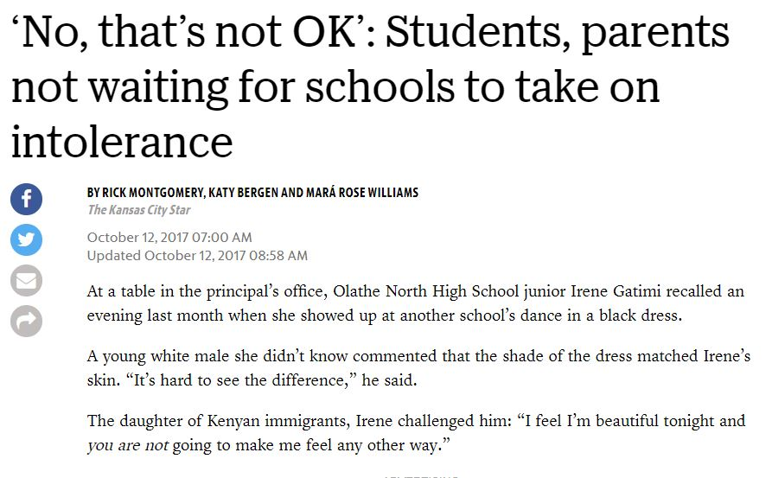
“If you are complacent, you are complicit.”
Combat Discrimination, Bullying & Violence
NATIONWIDE
20% of U.S. students in grades 9–12 experienced bullying.¹⁵
Bullied Others
Approximately 30% of young people admit to bullying others.³
Seen Bullying
70.6% of young people say they have seen bullying in their schools.³
62% of school staff witnessed bullying two or more times in the last month and 41% witness bullying once a week or more.³
When bystanders intervene, bullying stops within 10 seconds 57% of the time.¹⁶
When racial slurs, stereotypes, discrimination and prejudice permeate a school, everyone is affected, according to the National Association of School Psychologists. Eradicating racism is essential to ensuring that all pupils receive a quality education that leads to graduation and lifelong success.
Notes:
This slide reinforces all the negative outcomes when students cannot accept each other. Giant Step shows students all they have in common, so they see similarities not differences.

Slide 8
How to Help
Conference (including lunch) is completely FREE to all students.
Wayne State helps, but we must raise funds to cover 65% of expenses.
Sponsor a Teen for $50
Sponsor a Table for $350
Sponsor the Event for $1,000
Be a Legacy Sponsor for $5,000
Notes:
The tiers for recognition for giving are:
--- $5,000 and up "Legacy Sponsor" -- They will have their name and logo prominently displayed on all brochures, save-the-dates, fliers, press releases, e-newsletters, and the website. We would also distribute any branded materials about their organization to the students (if appropriate), and they get a few minutes to speak to the students at the start of the conference.
-- $1,000 - $4,999 "Event Sponsor" -- Listed prominently on our Giant Step website. Listed in press releases, school brochure, and throughout the conference on screens. We would distribute materials about their organization to students, if appropriate. If they are sponsoring a particular aspect of the conference, such as the food table, special signage will placed on that table.
-- $350 - $999 "Sponsor a Table of Teens" -- logo linked to their website on our Giant Step website. Organization name appears in list of Table Sponsors on PPT.
-- $50 "Sponsor-a-Student" -- their name appears in a list of all student sponsors on a revolving PPT during the conference.

Slide 9
Join our Sponsors
The Co-Ette Club , Inc. Detroit Chapter

Slide 10
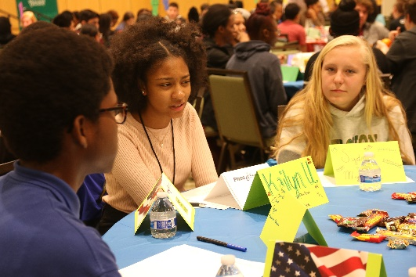
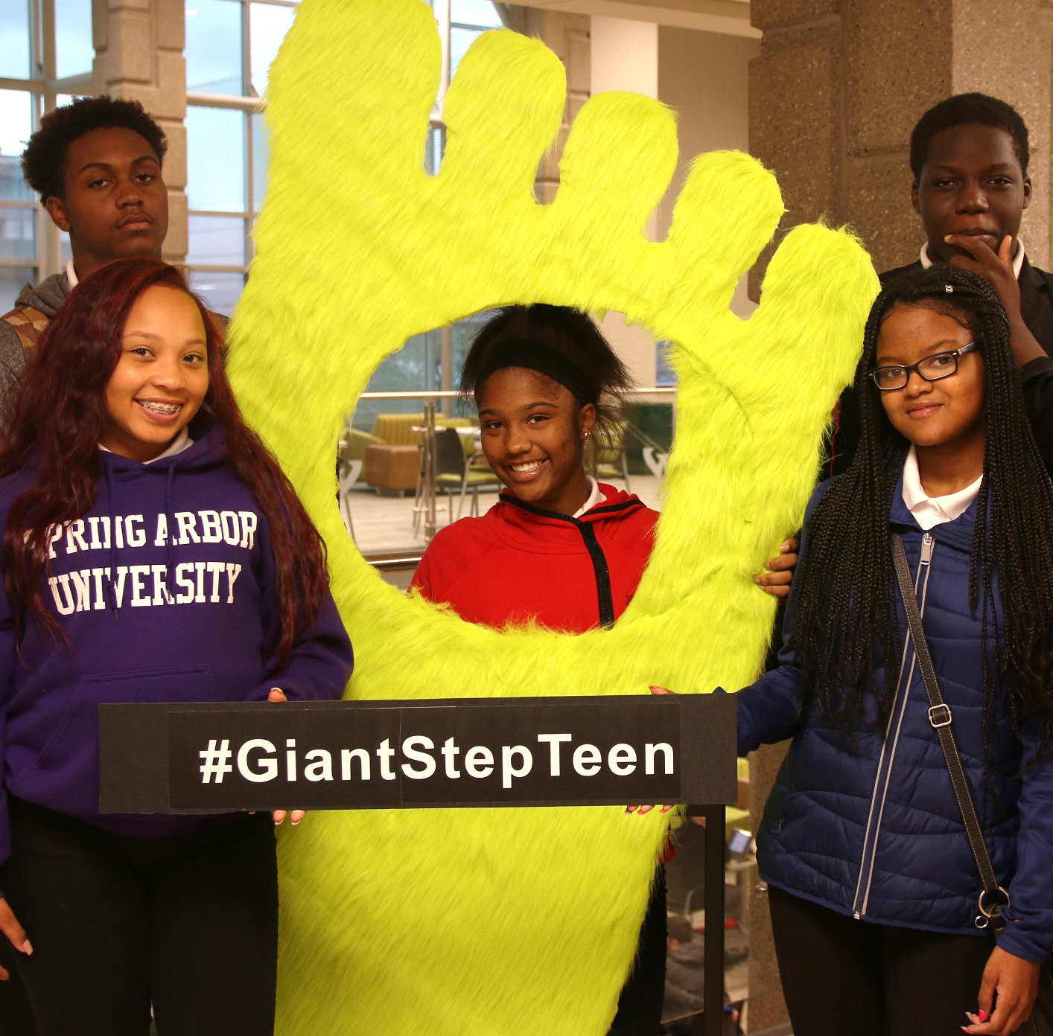
Support the Giant Step Teen Conference
Where differences are respected and similarities are uncovered.
Inclusion, Harmony, Acceptance

